Slide 1
Overfitting , underfitting, best fit
Created by: Mahipal Singh

Slide 2
What is Model Fitting?
A model "fits" data by learning patterns
The goal is to learn the general trend, not memorize or miss the data

Slide 3
Underfitting
Definition: Model is too simple, cannot capture the trend
Example: Linear model on curved data
Result: High error on training and test data
Analogy: Student writes very generic answers, ignoring the actual question

Slide 4
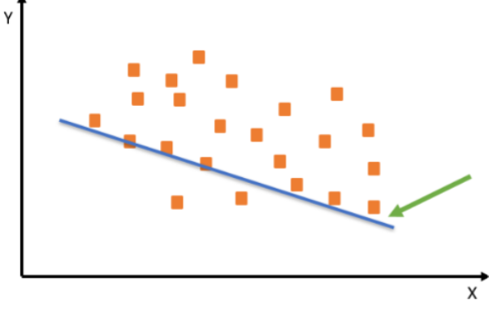

Slide 5
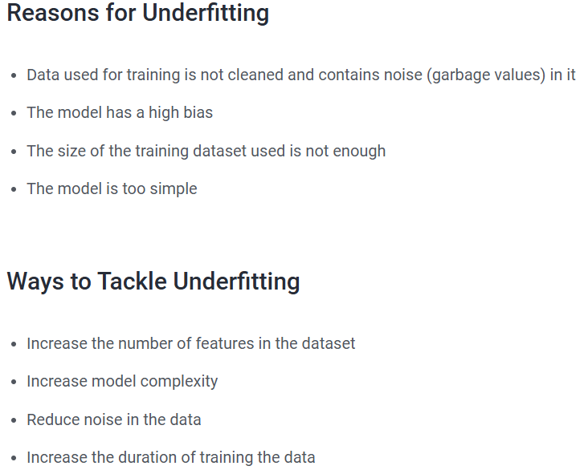

Slide 6
Overfitting
Definition: Model is too complex, memorizes training data
Example: High-degree polynomial on noisy data
Result: Low training error, high test error
Analogy: Student memorizes past paper; fails if questions change

Slide 7
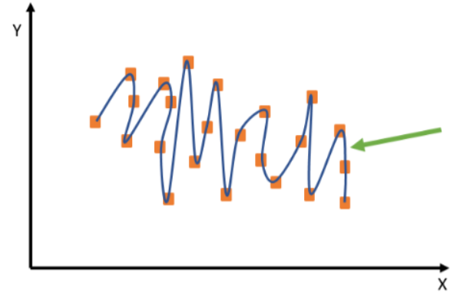

Slide 8
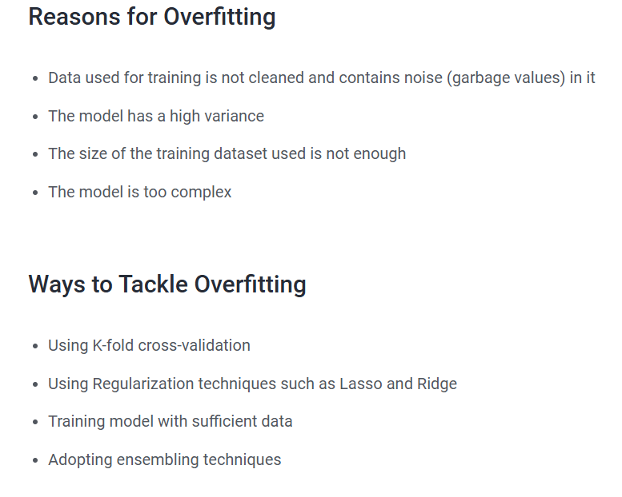

Slide 9
Best Fit (Good Fit)
Definition: Model that generalizes well
Example: Polynomial of suitable degree
Result: Low training and test error
Analogy: Student understands concepts, answers correctly even on new questions

Slide 10
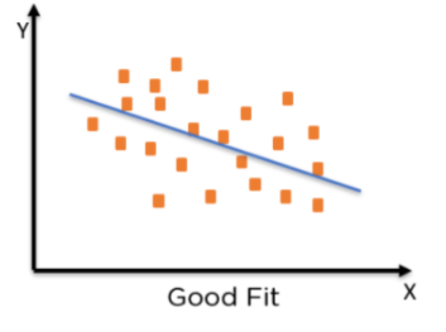

Slide 11
